Slide 1
Computer Organization and Assembly Language
By Abdual Qaddous

Slide 2
Memory Hierarchy
A typical register file stores only a few hundred bytes of information, as opposed to billions of bytes in the main memory.
The processor can read data from the register file almost 100 times faster than from memory.
To deal with the processor–memory gap, system designers include smaller, faster storage devices called cache memories (or simply caches) that serve as temporary staging areas for information that the processor is likely to need in the near future.

Slide 3
Cache
Newer and more powerful systems even have three levels of cache: L1, L2, and L3.
The idea behind caching is that a system can get the effect of both a very large memory and a very fast one by exploiting locality.
The tendency for programs to access data and code in localized regions.

Slide 4
Types of Cashe
An L1 cache on the processor chip holds tens of thousands of bytes and can be accessed nearly as fast as the register file.
A larger L2 cache with hundreds of thousands to millions of bytes is connected to the processor by a special bus. It might take 5 times longer for the processor to access the L2 cache than the L1 cache.
The L1 and L2 caches are implemented with a hardware technology known as static random access memory
(SRAM).

Slide 5
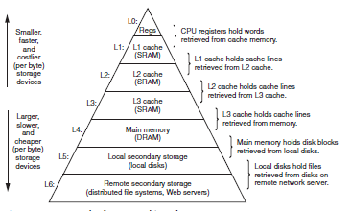

Slide 6

The Operating System Manages the Hardware
Program is loaded by shell(Hello).
Program print its message(welcome) it call services provider rather then directly access to neighbors components(keyboard, display, disk, or main memory )
The operating system as a layer of software interposed between the application program and the hardware.
All attempts by an application program to manipulate the hardware must go through the operating system.
The operating system has two primary purposes:
To protect the hardware from misuse by runaway applications
To provide applications with simple and uniform mechanisms for manipulating complicated and often wildly different low-level hardware devices.

Slide 7
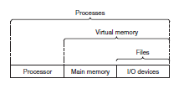
Cont..
The operating system achieves both goals via the fundamental abstractions processes, virtual memory, and files.
Files are abstractions for I/O devices, virtual memory is an abstraction for both the main memory and disk I/O devices, and processes are abstractions for the processor, main memory, and I/O devices.

Slide 8
Processes
When a program such as hello runs on a modern system, the operating system provides the illusion that the only one program is running on the system.
The program appears to have exclusive use of both the processor, main memory, and I/O devices.
The processor appears to execute the instructions in the program, one after the other, without interruption And the code and data of the program appear to be the only objects in the system’s memory.
A process is the operating system’s abstraction for a running program. Multiple processes can run concurrently on the same system, and each process appears to have exclusive use of the hardware.
Traditional systems could only execute one program at a time, while newer multicore processors can execute several programs simultaneously.
In either case, a single CPU can appear to execute multiple processes concurrently by having the processor switch among them.
The operating system performs this interleaving with a mechanism known as context switching

Slide 9
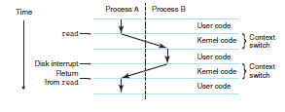
The operating system keeps track of all the state information that the process needs in order to run. This state, which is known as the context, includes information such as the current values of the PC, the register file, and the contents of main memory.
At any point in time, a uniprocessor system can only execute the code for a single process. When the operating system decides to transfer control from the current process to some new process, it performs a context switch by saving the context of the current process, restoring the context of the new process then passing control to the new process.
The new process picks up exactly where it left off.
Context Switching

Slide 10
There are two concurrent processes in our example scenario: the shell process and the hello process.
Initially, the shell process is running alone, waiting for input on the command line.
When we ask it to run the hello program, the shell carries out our request by invoking a special function known as a system call that passes control to the operating system.
The operating system saves the shell’s context, creates a new hello process and its context, and then passes control to the new hello process.
After hello terminates, the operating system restores the context of the shell process and passes control back to it, where it waits for the next command-line input.
The transition from one process to another is managed by the operating system kernel.
Context Switching

Slide 11
The kernel is the portion of the operating system code that is always resident in memory. When an application program requires some action by the operating system, such as to read or write a file, it executes a special system call instruction, transferring control to the kernel.
The kernel then performs the requested operation and returns back to the application program.
The kernel is not a separate process. Instead, it is a collection of code and data structures that the system uses to manage all the processes.
kernel

Slide 12
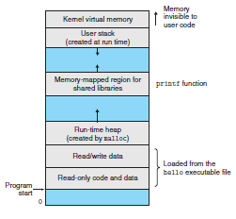
Threads
We normally think of a process as having a single control flow,
In modern systems a process can actually consist of multiple execution units, called threads, each running in the context of the process and sharing the same code and global data.
Multi-threading is also one way to make programs run faster

Slide 13
Virtual Memory
Virtual memory is an abstraction that provides each process with the illusion that it has exclusive use of the main memory.
Each process has the same uniform view of memory, which is known as its virtual address space.
The virtual address space seen by each process consists of a number of well defined areas, each with a specific purpose
Program code and data.
Code begins at the same fixed address for all processes, followed by data locations that correspond to global C variables. The code and data areas are initialized directly from the contents of an executable object file—in our case, the hello executable.
Heap.
The code and data areas are followed immediately by the run-time heap. Unlike the code and data areas, which are fixed in size once the process begins running, the heap expands and contracts dynamically at run time as a result of calls to C standard library routines such as malloc and free

Slide 14
Shared libraries.
Near the middle of the address space is an area that holds the code and data for shared libraries such as the C standard library and the math library.
The notion of a shared library is a powerful but somewhat difficult concept.
Stack.
At the top of the user’s virtual address space is the user stack that the compiler uses to implement function calls.
Like the heap, the user stack expands and contracts dynamically during the execution of the program.
In particular, each time we call a function, the stack grows. Each time we return from a function, it contracts.
Kernel virtual memory
The top region of the address space is reserved for the kernel.
Application programs are not allowed to read or write the contents of this area or to directly call functions defined in the kernel code. Instead, they must invoke the kernel to perform these operations

Slide 15

Files
A file is a sequence of bytes, nothing more and nothing less. Every I/O device, including disks, keyboards, displays, and even networks, is modeled as a file.
All input and output in the system is performed by reading and writing files, using a small set of system calls known as Unix I/O.

